Slide 1
Lecture 12: The IO Model & External Sorting
Lecture 12

Slide 2
Announcements
Announcements
Thank you for the great feedback (post coming soon)!
Educational goals:
Tech changes, principles change more slowly We teach principles and formal abstraction so you can adapt to a changing world and technology..
Ability to learn after you leave. Why we give you new concepts in homeworks & projects. We want you to be able to pick up those changing concepts. But we test you fairly.
We select the essentials for you. We’ve thought about the material quite a bit. Feedback helpful, but we’d hope to get the benefit of the doubt. ☺
3. Thank you for being awesome wrt the midterm.
… some of you started early... Not cool.
SCPD people, a lot of you were great!

Slide 3
Today’s Lecture
Lecture 12
[From 9-2]: Conflict Serializability & Deadlock
The Buffer
External Merge Sort

Slide 4
1. Conflict Serializability & Deadlock
Lecture 12 > Section 1
Recap from Lecture 9-2

Slide 5
What you will learn about in this section
Lecture 12 > Section 1
RECAP: Concurrency
Conflict Serializability
DAGs & Topological Orderings
Strict 2PL
Deadlocks

Slide 6
Recall: Concurrency as Interleaving TXNs
Lecture 12 > Section 1 > Concurrency
Serial Schedule:
For our purposes, having TXNs occur concurrently means interleaving their component actions (R/W)
T₁
R(A)
W(A)
R(B)
W(B)
T₂
R(A)
W(A)
R(B)
W(B)
Interleaved Schedule:
We call the particular order of interleaving a schedule
T₁
R(A)
W(A)
R(B)
W(B)
T₂
R(A)
W(A)
R(B)
W(B)

Slide 7
Recall: Why Interleave TXNs?
Lecture 12 > Section 1 > Concurrency
Interleaving TXNs might lead to anomalous outcomes… why do it?
Several important reasons:
Individual TXNs might be slow- don’t want to block other users during!
Disk access may be slow- let some TXNs use CPUs while others accessing disk!
All concern large differences in performance

Slide 8
Recall: Must Preserve Consistency & Isolation
Lecture 12 > Section 1 > Concurrency
The DBMS has freedom to interleave TXNs
However, it must pick an interleaving or schedule such that isolation and consistency are maintained
Must be as if the TXNs had executed serially!
“With great power comes great responsibility”
ACID
DBMS must pick a schedule which maintains isolation & consistency

Slide 9
Recall: “Good” vs. “bad” schedules
Lecture 12 > Section 1 > Concurrency
Serial Schedule:
Interleaved Schedules:
T₁
R(A)
W(A)
R(B)
W(B)
T₁
R(A)
W(A)
R(B)
W(B)
T₂
R(A)
W(A)
R(B)
W(B)
T₂
R(A)
W(A)
R(B)
W(B)
X
Why?
T₁
R(A)
W(A)
R(B)
W(B)
T₂
R(A)
W(A)
R(B)
W(B)
We want to develop ways of discerning “good” vs. “bad” schedules

Slide 10
Ways of Defining “Good” vs. “Bad” Schedules
Lecture 12 > Section 1 > Concurrency
Recall from last time: we call a schedule serializable if it is equivalent to some serial schedule
We used this as a notion of a “good” interleaved schedule, since a serializable schedule will maintain isolation & consistency
Now, we’ll define a stricter, but very useful variant:
Conflict serializability
We’ll need to define conflicts first..

Slide 11
Conflicts
Lecture 12 > Section 1 > Conflict Serializability
Two actions conflict if they are part of different TXNs, involve the same variable, and at least one of them is a write
T₁
R(A)
W(A)
R(B)
W(B)
W-W Conflict
T₂
W-R Conflict
R(A)
W(A)
R(B)
W(B)

Slide 12
Conflicts
Lecture 12 > Section 1 > Conflict Serializability
Two actions conflict if they are part of different TXNs, involve the same variable, and at least one of them is a write
T₁
R(A)
W(A)
R(B)
W(B)
T₂
R(A)
W(A)
R(B)
W(B)
All “conflicts”!

Slide 13
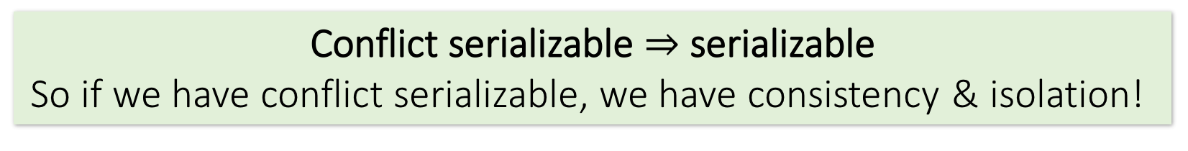
Conflict Serializability
Lecture 12 > Section 1 > Conflict Serializability
Two schedules are conflict equivalent if:
They involve the same actions of the same TXNs
Every pair of conflicting actions of two TXNs are ordered in the same way
Schedule S is conflict serializable if S is conflict equivalent to some serial schedule
Conflict serializable $⇒$ serializable
So if we have conflict serializable, we have consistency & isolation!

Slide 14
Recall: “Good” vs. “bad” schedules
Lecture 12 > Section 1 > Conflict Serializability
Serial Schedule:
Interleaved Schedules:
T₁
R(A)
W(A)
R(B)
W(B)
T₁
R(A)
W(A)
R(B)
W(B)
T₂
R(A)
W(A)
R(B)
W(B)
T₂
R(A)
W(A)
R(B)
W(B)
X
Note that in the “bad” schedule, the order of conflicting actions is different than the above (or any) serial schedule!
T₁
R(A)
W(A)
R(B)
W(B)
T₂
R(A)
W(A)
R(B)
W(B)
Conflict serializability also provides us with an operative notion of “good” vs. “bad” schedules!

Slide 15
Note: Conflicts vs. Anomalies
Lecture 12 > Section 1 > Conflict Serializability
Conflicts are things we talk about to help us characterize different schedules
Present in both “good” and “bad” schedules
Anomalies are instances where isolation and/or consistency is broken because of a “bad” schedule
We often characterize different anomaly types by what types of conflicts predicated them

Slide 16
The Conflict Graph
Lecture 12 > Section 1 > Conflict Serializability
Let’s now consider looking at conflicts at the TXN level
Consider a graph where the nodes are TXNs, and there is an edge from T_{i} →T_{j} if any actions in T_{i} precede and conflict with any actions in T_{j}
T₁
R(A)
W(A)
R(B)
W(B)
T₂
T₁
T₂
R(A)
W(A)
R(B)
W(B)

Slide 17
Lecture 12 > Section 1 > Conflict Serializability
What can we say about “good” vs. “bad” conflict graphs?
Serial Schedule:
Interleaved Schedules:
T₁
R(A)
W(A)
R(B)
W(B)
T₁
R(A)
W(A)
R(B)
W(B)
T₂
R(A)
W(A)
R(B)
W(B)
T₂
R(A)
W(A)
R(B)
W(B)
X
A bit complicated…
T₁
R(A)
W(A)
R(B)
W(B)
T₂
R(A)
W(A)
R(B)
W(B)

Slide 18
Lecture 12 > Section 1 > Conflict Serializability
What can we say about “good” vs. “bad” conflict graphs?
Serial Schedule:
Interleaved Schedules:
T₁
T₂
T₁
T₂
X
Simple!
T₁
T₂
Theorem: Schedule is conflict serializable if and only if its conflict graph is acyclic

Slide 19
Let’s unpack this notion of acyclic conflict graphs…
Lecture 12 > Section 1 > Conflict Serializability

Slide 20
DAGs & Topological Orderings
Lecture 12 > Section 1 > Topological orderings
A topological ordering of a directed graph is a linear ordering of its vertices that respects all the directed edges
A directed acyclic graph (DAG) always has one or more topological orderings
(And there exists a topological ordering if and only if there are no directed cycles)

Slide 21
DAGs & Topological Orderings
Lecture 12 > Section 1 > Topological orderings
Ex: What is one possible topological ordering here?
0
Ex: 0, 1, 2, 3 (or: 0, 1, 3, 2)
1
2
3

Slide 22
DAGs & Topological Orderings
Lecture 12 > Section 1 > Topological orderings
Ex: What is one possible topological ordering here?
0
1
There is none!
2
3

Slide 23
Connection to conflict serializability
Lecture 12 > Section 1 > Topological orderings
In the conflict graph, a topological ordering of nodes corresponds to a serial ordering of TXNs
Thus an acyclic conflict graph → conflict serializable!
Theorem: Schedule is conflict serializable if and only if its conflict graph is acyclic

Slide 24
Strict Two-Phase Locking
Lecture 12 > Section 1 > Strict 2PL
We consider locking- specifically, strict two-phase locking- as a way to deal with concurrency, because is guarantees conflict serializability (if it completes- see upcoming…)
Also (conceptually) straightforward to implement, and transparent to the user!

Slide 25
Strict Two-phase Locking (Strict 2PL) Protocol:
Lecture 12 > Section 1 > Strict 2PL
TXNs obtain:
An X (exclusive) lock on object before writing.
If a TXN holds, no other TXN can get a lock (S or X) on that object.
An S (shared) lock on object before reading
If a TXN holds, no other TXN can get an X lock on that object
All locks held by a TXN are released when TXN completes.
Note: Terminology here- “exclusive”, “shared”- meant to be intuitive- no tricks!

Slide 26
Picture of 2-Phase Locking (2PL)
Lecture 12 > Section 1 > Strict 2PL
# Locks the TXN has
Lock Acquisition
Lock Release
On TXN commit!
0 locks
Time
Strict 2PL

Slide 27
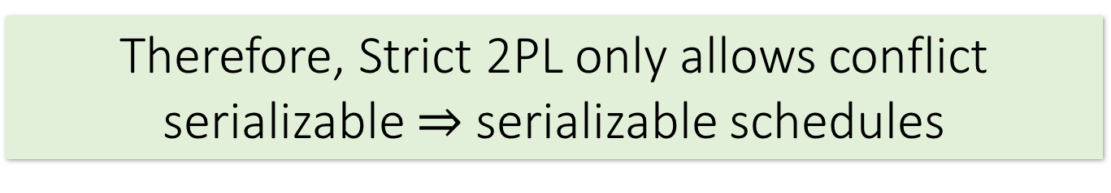
Strict 2PL
Lecture 12 > Section 1 > Strict 2PL
Theorem: Strict 2PL allows only schedules whose dependency graph is acyclic
Proof Intuition: In strict 2PL, if there is an edge T_{i} → T_{j} (i.e. T_{i} and T_{j} conflict) then T_{j} needs to wait until T_{i} is finished – so cannot have an edge T_{j} → T_{i}
Therefore, Strict 2PL only allows conflict serializable $⇒$ serializable schedules

Slide 28
Strict 2PL
Lecture 12 > Section 1 > Strict 2PL
If a schedule follows strict 2PL and locking, it is conflict serializable…
…and thus serializable
…and thus maintains isolation & consistency!
Not all serializable schedules are allowed by strict 2PL.
So let’s use strict 2PL, what could go wrong?

Slide 29
Deadlock Detection: Example
Lecture 12 > Section 1 > Deadlocks
Waits-for graph:
T₁
S(A)
R(A)
T₁
T₂
T₂
First, T₁ requests a shared lock on A to read from it

Slide 30
Deadlock Detection: Example
Lecture 12 > Section 1 > Deadlocks
Waits-for graph:
T₁
S(A)
R(A)
T₁
T₂
T₂
S(B)
R(B)
Next, T₂ requests a shared lock on B to read from it

Slide 31
Deadlock Detection: Example
Lecture 12 > Section 1 > Deadlocks
Waits-for graph:
T₁
S(A)
R(A)
T₁
T₂
T₂
Waiting…
S(B)
R(B)
X(A)
W(A)
T₂ then requests an exclusive lock on A to write to it- now T₂ is waiting on T₁…

Slide 32
Deadlock Detection: Example
Lecture 12 > Section 1 > Deadlocks
Waits-for graph:
T₁
S(A)
R(A)
X(B)
Waiting…
T₁
T₂
W(B)
T₂
Waiting…
S(B)
R(B)
X(A)
W(A)
Cycle = DEADLOCK
Finally, T₁ requests an exclusive lock on B to write to it- now T₁ is waiting on T₂… DEADLOCK!

Slide 33


The problem? Deadlock!??!
Lecture 12 > Section 1 > Deadlocks
ERROR: deadlock detected
DETAIL: Process 321 waits for ExclusiveLock on tuple of relation 20 of database 12002; blocked by process 4924.
Process 404 waits for ShareLock on transaction 689; blocked by process 552.
HINT: See server log for query details.
T₁
T₂
NB: Also movie called wedlock (deadlock) set in a futuristic prison…
I haven’t seen either of them…
Notes:
http://elioxman.blogspot.com/2013/02/postgres-deadlock.html

Slide 34
Deadlocks
Lecture 12 > Section 1 > Deadlocks
Deadlock: Cycle of transactions waiting for locks to be released by each other.
Two ways of dealing with deadlocks:
Deadlock prevention
Deadlock detection

Slide 35
Deadlock Detection
Lecture 12 > Section 1 > Deadlocks
Create the waits-for graph:
Nodes are transactions
There is an edge from T_{i} → T_{j} if T_{i} is waiting for T_{j} to release a lock
Periodically check for (and break) cycles in the waits-for graph

Slide 36
Summary
Lecture 12 > Section 1
Last lecture: Concurrency achieved by interleaving TXNs such that isolation & consistency are maintained
We formalized a notion of serializability that captured such a “good” interleaving schedule
We defined conflict serializability, which implies serializability
There are other, more general issues!
Locking allows only conflict serializable schedules
If the schedule completes- it may deadlock!

Slide 37
Candy Break

Slide 38
2. The Buffer
Lecture 12 > Section 2

Slide 39
Transition to Mechanisms
Lecture 12 > Section 2
So you can understand what the database is doing!
Understand the CS challenges of a database and how to use it.
Understand how to optimize a query
2. Many mechanisms have become stand-alone systems
Indexing to Key-value stores
Embedded join processing
SQL-like languages take some aspect of what we discuss (PIG, Hive)

Slide 40
What you will learn about in this section
Lecture 12 > Section 2
RECAP: Storage and memory model
Buffer primer

Slide 41
High-level: Disk vs. Main Memory
Lecture 12 > Section 2 > Storage & memory model
Cylinder
Spindle
Disk head
Tracks
Sector
Arm movement
Platters
Arm assembly
Disk:
Slow: Sequential block access
Read a blocks (not byte) at a time, so sequential access is cheaper than random
Disk read / writes are expensive!
Durable: We will assume that once on disk, data is safe!
Cheap
Random Access Memory (RAM) or Main Memory:
Fast: Random access, byte addressable
~10x faster for sequential access
~100,000x faster for random access!
Volatile: Data can be lost if e.g. crash occurs, power goes out, etc!
Expensive: For $100, get 16GB of RAM vs. 2TB of disk!

Slide 42
The Buffer
Lecture 12 > Section 2 > The Buffer
Main Memory
A buffer is a region of physical memory used to store temporary data
In this lecture: a region in main memory used to store intermediate data between disk and processes
Key idea: Reading / writing to disk is slow- need to cache data!
Buffer
Disk

Slide 43
The (Simplified) Buffer
Lecture 12 > Section 2 > The Buffer
Main Memory
In this class: We’ll consider a buffer located in main memory that operates over pages and files:
Buffer
Read(page): Read page from disk -> buffer if not already in buffer
Disk
1,0,3
1,0,3

Slide 44
The (Simplified) Buffer
Lecture 12 > Section 2 > The Buffer
Main Memory
In this class: We’ll consider a buffer located in main memory that operates over pages and files:
Buffer
2
0
1,0,3
Read(page): Read page from disk -> buffer if not already in buffer
Processes can then read from / write to the page in the buffer
Disk
1,0,3

Slide 45
The (Simplified) Buffer
Lecture 12 > Section 2 > The Buffer
Main Memory
In this class: We’ll consider a buffer located in main memory that operates over pages and files:
Buffer
1,2,3
Read(page): Read page from disk -> buffer if not already in buffer
Flush(page): Evict page from buffer & write to disk
Disk
1,0,3

Slide 46
The (Simplified) Buffer
Lecture 12 > Section 2 > The Buffer
Main Memory
In this class: We’ll consider a buffer located in main memory that operates over pages and files:
Buffer
1,2,3
Read(page): Read page from disk -> buffer if not already in buffer
Flush(page): Evict page from buffer & write to disk
Disk
Release(page): Evict page from buffer without writing to disk
1,0,3

Slide 47
Managing Disk: The DBMS Buffer
Lecture 12 > Section 2 > The Buffer
Main Memory
Buffer
Database maintains its own buffer
Why? The OS already does this…
DB knows more about access patterns.
Watch for how this shows up! (cf. Sequential Flooding)
Recovery and logging require ability to flush to disk.
Disk

Slide 48
The Buffer Manager
Lecture 12 > Section 2 > The Buffer
A buffer manager handles supporting operations for the buffer:
Primarily, handles & executes the “replacement policy”
i.e. finds a page in buffer to flush/release if buffer is full and a new page needs to be read in
DBMSs typically implement their own buffer management routines

Slide 49
A Simplified Filesystem Model
Lecture 12 > Section 2 > The Buffer
For us, a page is a fixed-sized array of memory
Think: One or more disk blocks
Interface:
write to an entry (called a slot) or set to “None”
DBMS also needs to handle variable length fields
Page layout is important for good hardware utilization as well (see 346)
And a file is a variable-length list of pages
Interface: create / open / close; next_page(); etc.
Disk
File
1,0,3
1,0,3
Page

Slide 50
2. External Merge & Sort
Lecture 12 > Section 3

Slide 51
What you will learn about in this section
Lecture 12 > Section 3
External Merge- Basics
External Merge- Extensions
External Sort

Slide 52
External Merge
Lecture 12 > Section 3 > External merge

Slide 53
Challenge: Merging Big Files with Small Memory
Lecture 12 > Section 3 > External merge
How do we efficiently merge two sorted files when both are much larger than our main memory buffer?

Slide 54
External Merge Algorithm
Lecture 12 > Section 3 > External merge
Input: 2 sorted lists of length M and N
Output: 1 sorted list of length M + N
Required: At least 3 Buffer Pages
IOs: 2(M+N)

Slide 55
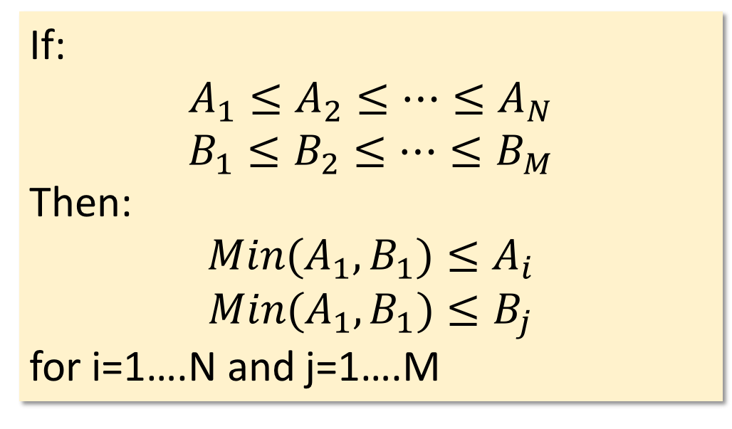
Key (Simple) Idea
Lecture 12 > Section 3 > External merge
To find an element that is no larger than all elements in two lists, one only needs to compare minimum elements from each list.
If:
$$A_{1}≤A_{2}≤…≤A_{N}$$
$$B_{1}≤B_{2}≤…≤B_{M}$$
Then:
$${Min(A}_{1},B_{1})≤A_{i}$$
$${Min(A}_{1},B_{1})≤B_{j}$$
for i=1….N and j=1….M

Slide 56
External Merge Algorithm
Lecture 12 > Section 3 > External merge
Main Memory
Buffer
Input:
Two sorted files
1,5
7,11
20,31
F₁
F₂
2,22
23,24
25,30
Output:
One merged sorted file
Disk

Slide 57
External Merge Algorithm
Lecture 12 > Section 3 > External merge
Main Memory
Buffer
Input:
Two sorted files
7,11
20,31
F₁
1,5
2,22
F₂
23,24
25,30
Output:
One merged sorted file
Disk

Slide 58
External Merge Algorithm
Lecture 12 > Section 3 > External merge
Main Memory
Buffer
Input:
Two sorted files
7,11
20,31
F₁
5
22
1,2
F₂
23,24
25,30
Output:
One merged sorted file
Disk

Slide 59
External Merge Algorithm
Lecture 12 > Section 3 > External merge
Main Memory
Buffer
Input:
Two sorted files
7,11
20,31
F₁
5
22
F₂
23,24
25,30
Output:
One merged sorted file
1,2
Disk

Slide 60
External Merge Algorithm
Lecture 12 > Section 3 > External merge
Main Memory
Buffer
Input:
Two sorted files
7,11
20,31
F₁
22
5
F₂
23,24
25,30
Output:
One merged sorted file
1,2
This is all the algorithm “sees”… Which file to load a page from next?
Disk

Slide 61
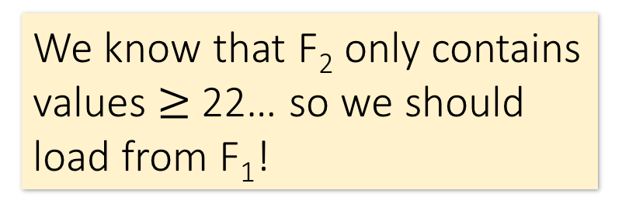
External Merge Algorithm
Lecture 12 > Section 3 > External merge
Main Memory
Buffer
Input:
Two sorted files
7,11
20,31
F₁
22
5
F₂
23,24
25,30
Output:
One merged sorted file
1,2
We know that F₂ only contains values $≥$ 22… so we should load from F₁!
Disk

Slide 62
External Merge Algorithm
Lecture 12 > Section 3 > External merge
Main Memory
Buffer
Input:
Two sorted files
20,31
F₁
7,11
22
5
F₂
23,24
25,30
Output:
One merged sorted file
1,2
Disk

Slide 63
External Merge Algorithm
Lecture 12 > Section 3 > External merge
Main Memory
Buffer
Input:
Two sorted files
20,31
F₁
11
22
5,7
F₂
23,24
25,30
Output:
One merged sorted file
1,2
Disk

Slide 64
External Merge Algorithm
Lecture 12 > Section 3 > External merge
Main Memory
Buffer
Input:
Two sorted files
20,31
F₁
11
22
F₂
23,24
25,30
Output:
One merged sorted file
1,2
5,7
Disk

Slide 65
External Merge Algorithm
Lecture 12 > Section 3 > External merge
Main Memory
Buffer
Input:
Two sorted files
20,31
F₁
22
11
F₂
23,24
25,30
Output:
One merged sorted file
1,2
5,7
And so on…
See IPython demo!
Disk

Slide 66
We can merge lists of arbitrary length with only 3 buffer pages.
Lecture 12 > Section 3 > External merge
If lists of size M and N, then
Cost: 2(M+N) IOs
Each page is read once, written once
With B+1 buffer pages, can merge B lists. How?

Slide 67
External (Merge) Sort
Lecture 12 > Section 3 > External sort

Slide 68
Why are Sort Algorithms Important?
Lecture 12 > Section 3 > External sort
Data requested from DB in sorted order is extremely common
e.g., find students in increasing GPA order
Why not just use quicksort in main memory??
What about if we need to sort 1TB of data with 1GB of RAM…
A classic problem in computer science!
Notes:
4

Slide 69
More reasons to sort…
Lecture 12 > Section 3 > External sort
Sorting useful for eliminating duplicate copies in a collection of records (Why?)
Sorting is first step in bulk loading B+ tree index.
Sort-merge join algorithm involves sorting
Next lecture!
The lecture after next…

Slide 70

Do people care?
Lecture 12 > Section 3 > External sort
http://sortbenchmark.org
Sort benchmark bears his name

Slide 71
Simplified External Sorts.
Lecture 12 > Section 3 > External sort

Slide 72
So how do we sort big files?
Lecture 12 > Section 3 > External sort
Split into chunks small enough to sort in memory
Merge each pair of sorted chunks using the external merge algorithm
Merge pairs of these resulting chunks…
Repeat until all merged (and sorted!)

Slide 73
External Merge Sort Algorithm
Lecture 12 > Section 3 > External merge
Example:
3 Buffer pages
6-page file
Disk
Main Memory
Buffer
F₁
44,10
33,12
55,31
F₂
18,22
27,24
3,1
Split into chunks small enough to sort in memory

Slide 74
External Merge Sort Algorithm
Lecture 12 > Section 3 > External merge
Example:
3 Buffer pages
6-page file
Disk
Main Memory
Buffer
F₁
44,10
33,12
55,31
F₂
18,22
27,24
3,1
Split into chunks small enough to sort in memory

Slide 75
External Merge Sort Algorithm
Lecture 12 > Section 3 > External merge
Example:
3 Buffer pages
6-page file
Disk
Main Memory
Buffer
F₁
44,10
33,12
55,31
F₂
18,22
27,24
3,1
Split into chunks small enough to sort in memory

Slide 76
External Merge Sort Algorithm
Lecture 12 > Section 3 > External merge
Example:
3 Buffer pages
6-page file
Disk
Main Memory
Buffer
F₁
10,12
31,33
44,55
F₂
18,22
27,24
3,1
Split into chunks small enough to sort in memory

Slide 77
External Merge Sort Algorithm
Lecture 12 > Section 3 > External merge
Example:
3 Buffer pages
6-page file
Disk
Main Memory
Buffer
F₁
10,12
31,33
44,55
1,3
18,22
24,27
F₂
18,22
27,24
3,1
And similarly for F₂
Split into chunks small enough to sort in memory

Slide 78
External Merge Sort Algorithm
Lecture 12 > Section 3 > External merge
Example:
3 Buffer pages
6-page file
Disk
Main Memory
Buffer
F₁
10,12
31,33
44,55
F₂
1,3
18,22
24,27
2. Now just run the external merge algorithm & we’re done!

Slide 79
Calculating IO Cost
Lecture 12 > Section 3 > External sort
For 3 buffer pages, 6 page file:
Split into two 3-page files and sort in memory
= 1 R + 1 W for each page = 2*(3 + 3) = 12 IO operations
Merge each pair of sorted chunks using the external merge algorithm
= 2*(3 + 3) = 12 IO operations
Total cost = 24 IO

Slide 80
Running External Merge Sort on Larger Files
Lecture 12 > Section 3 > External merge
Assume we still only have 3 buffer pages (Buffer not pictured)
Disk
10,12
31,33
44,55
45,38
18,43
24,27
10,12
31,33
47,55
41,3
18,22
23,20
42,46
31,33
39,55
1,3
18,23
24,27
10,12
48,33
44,40
16,31
18,22
24,27

Slide 81
Running External Merge Sort on Larger Files
Lecture 12 > Section 3 > External merge
Assume we still only have 3 buffer pages (Buffer not pictured)
Disk
1. Split into files small enough to sort in buffer…
10,12
31,33
44,55
45,38
18,43
24,27
10,12
31,33
47,55
41,3
18,22
23,20
42,46
31,33
39,55
1,3
18,23
24,27
10,12
48,33
44,40
16,31
18,22
24,27

Slide 82
Running External Merge Sort on Larger Files
Lecture 12 > Section 3 > External merge
Assume we still only have 3 buffer pages (Buffer not pictured)
Disk
1. Split into files small enough to sort in buffer… and sort
10,12
31,33
44,55
18,24
27,38
43,45
10,12
31,33
47,55
3,18
20,22
23,41
31,33
39,42
46,55
1,3
18,23
24,27
10,12
33,40
44,48
16,18
22,24
27,31

Slide 83
Running External Merge Sort on Larger Files
Lecture 12 > Section 3 > External merge
Assume we still only have 3 buffer pages (Buffer not pictured)
Disk
Disk
10,12
31,33
44,55
10,12
18,24
27,31
18,24
27,38
43,45
33,38
43,44
45,55
2. Now merge pairs of (sorted) files… the resulting files will be sorted!
10,12
31,33
47,55
3,10
12,18
20,22
3,18
20,22
23,41
23,31
33,41
47,55
31,33
39,42
46,55
1,3
18,23
24,27
1,3
18,23
24,27
31,33
39,42
46,55
10,12
33,40
44,48
10,12
16,18
22,24
16,18
22,24
27,31
27,31
33,40
44,48

Slide 84
Running External Merge Sort on Larger Files
Lecture 12 > Section 3 > External merge
Assume we still only have 3 buffer pages (Buffer not pictured)
Disk
Disk
Disk
10,12
31,33
44,55
10,12
18,24
27,31
3,10
10,12
12,18
18,24
27,38
43,45
33,38
43,44
45,55
18,20
22,23
24,27
10,12
31,33
47,55
3,10
12,18
20,22
31,31
33,33
38,41
3. And repeat…
3,18
20,22
23,41
23,31
33,41
47,55
43,44
45,47
55,55
31,33
39,42
46,55
1,3
18,23
24,27
1,3
10,12
16,18
1,3
18,23
24,27
31,33
39,42
46,55
18,22
23,24
24,27
10,12
33,40
44,48
10,12
16,18
22,24
27,31
31,33
33,39
16,18
22,24
27,31
27,31
33,40
44,48
40,42
44,46
48,55

Slide 85
Running External Merge Sort on Larger Files
Lecture 12 > Section 3 > External merge
Disk
Disk
Disk
Disk
10,12
31,33
44,55
10,12
18,24
27,31
3,10
10,12
12,18
1,3
3,10
10,10
18,24
27,38
43,45
33,38
43,44
45,55
18,20
22,23
24,27
12,12
12,16
18,18
10,12
31,33
47,55
3,10
12,18
20,22
31,31
33,33
38,41
18,18
20,22
22,23
3,18
20,22
23,41
23,31
33,41
47,55
43,44
45,47
55,55
23,24
24,24
27,27
31,33
39,42
46,55
1,3
18,23
24,27
1,3
10,12
16,18
27,31
31,31
31,33
1,3
18,23
24,27
31,33
39,42
46,55
18,22
23,24
24,27
33,33
33,38
39,40
10,12
33,40
44,48
10,12
16,18
22,24
27,31
31,33
33,39
41,42
43,44
44,45
16,18
22,24
27,31
27,31
33,40
44,48
40,42
44,46
48,55
46,47
48,55
55,55
4. And repeat!

Slide 86
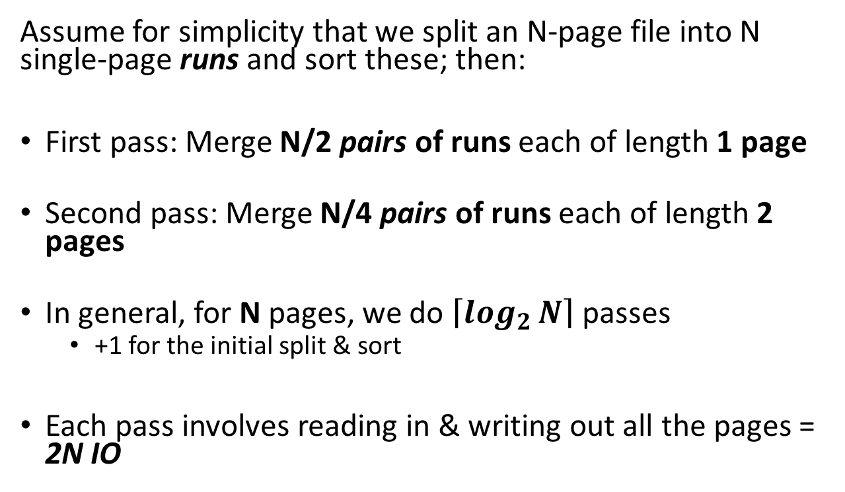

Simplified 3-page Buffer Version
Lecture 13 > Section 1 > External Merge Sort: Larger files
Unsorted input file
Assume for simplicity that we split an N-page file into N single-page runs and sort these; then:
First pass: Merge N/2 pairs of runs each of length 1 page
Second pass: Merge N/4 pairs of runs each of length 2 pages
In general, for N pages, we do $\left\lceil \log_{2}{N}\right\rceil$ passes
+1 for the initial split & sort
Each pass involves reading in & writing out all the pages = 2N IO
Split & sort
Merge
Merge
Sorted!
→ 2N*($\left\lceil \log_{2}{N}\right\rceil$+1) total IO cost!

Slide 87
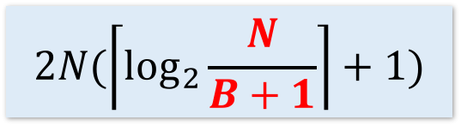
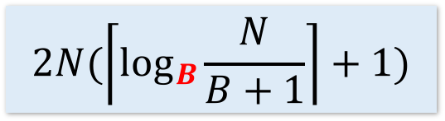
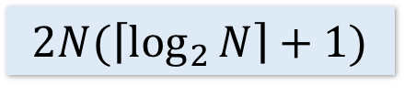
Using B+1 buffer pages to reduce passes
Lecture 12 > Section 3 > External merge
IO Cost:
Goal: Reduce the number of passes.
Suppose we have B+1 buffer pages and a file with N pages.
Each pass still takes 2N IOs.
1. Increase length of initial runs. Sort B at a time!
From N of length 1 to N/(B+1) runs each of length B
2. Perform a B way merge.
Given M runs each of length L, produce M/B runs of length LB.
$$2N(\left\lceil \log_{2}{N}\right\rceil +1)$$
$$2N(\left\lceil \log_{2}{\frac{N}{B+1}}\right\rceil +1)$$
$$2N(\left\lceil \log_{B}{\frac{N}{B+1}}\right\rceil +1)$$

Slide 88
Summary
Lecture 12 > Section 3 > External merge
Basics of IO and buffer management.
See notebook for more fun! (Learn about sequential flooding)
We introduced the IO cost model using sorting.
Saw how to do merges with few IOs,
Works better than main-memory sort algorithms.
Described a few optimizations for sorting

Slide 89
Number of Passes of External Sort
Engineer’s rule of thumb:
You sort in 3 passes
Notes:
9

Slide 90
Even longer initial runs
Suppose we have B+1 buffer pages.
Produce longer runs by “merging” as we read.
Read B buffer pages and merge them.
Twist: when input page is empty, read in a new page.
Issue: Some values on new page may be smaller than already output value.
Can’t output, these values call them frozen.
Try to consolidate frozen values in pages, to free up more pages.
Alternatively: Just use a priority queue—called tournament sort!
How long are the runs if input file is sorted in desired order?
Nothing is frozen!
How long are the runs if input file is sorted in reverse order?
All new values are frozen
Engineers approximation: Runs will have ~ 2(B+1) length.

Slide 91
Double Buffering
Which IOs are sequential in sorting?
Initial runs, both reading and writing are sequential writes.
Merge phase: writing is sequential, reading is not!
Can Improve performance by using bigger buffers to “prefetch” or “double buffer” to hide reads in merge-phase.
Prefetch: Hide latency
Bigger Batch Sizes: Amortize expensive random reads and writes, but reduce available buffer pages.
Surprisingly useful trick.

